Slide 1
Delightful User Experience
Android Developer Fundamentals
Lesson 5
This work is licensed under a Creative Commons Attribution-NonCommercial 4.0 International License

Slide 2
5.1 Drawables, Styles, Themes
This work is licensed under a Creative Commons Attribution-NonCommercial 4.0 International License

Slide 3
Contents
Drawables
Creating image assets
Styles
Themes

Slide 4
Drawables

Slide 5
Drawables
Drawable—generic Android class used to represent any kind of graphic
All drawables are stored in the res/drawable project folder

Slide 6
Drawable classes
Bitmap File
Nine-Patch File
Layer List Drawable
Shape Drawable
State List Drawable
Level List Drawable
Transition Drawable
Vector Drawable
… and more
Custom Drawables

Slide 7
Bitmaps
PNG (.png), JPG (.jpg), or GIF (.gif) format
Uncompressed BMP (.bmp)
WebP (4.0 and higher)
Creates a BitmapDrawable data type
Placed directly in res/drawables

Slide 8
Referencing Drawables
XML: @[package:]drawable/filename
<ImageView
android:layout_height="wrap_content"
android:layout_width="wrap_content"
android:src="@drawable/myimage" />
Java code: R.drawable.filename
Resources res = getResources();
Drawable drawable = res.getDrawable(R.drawable.myimage);

Slide 9
Nine-Patch Files
Nine-patch files (.9.png) are PNG with stretchable regions
Only stretches bigger, not smaller, so start with small image
Often used for backgrounds of UI elements
Example: button background changes size with label length
Good intro

Slide 10
Creating Nine-Patch Files
Put a small PNG file into res/drawable
Right-click and choose Create 9-Patch file
Double-click 9-Patch file to open editor
Specify the stretchable regions (next slide)

Slide 11
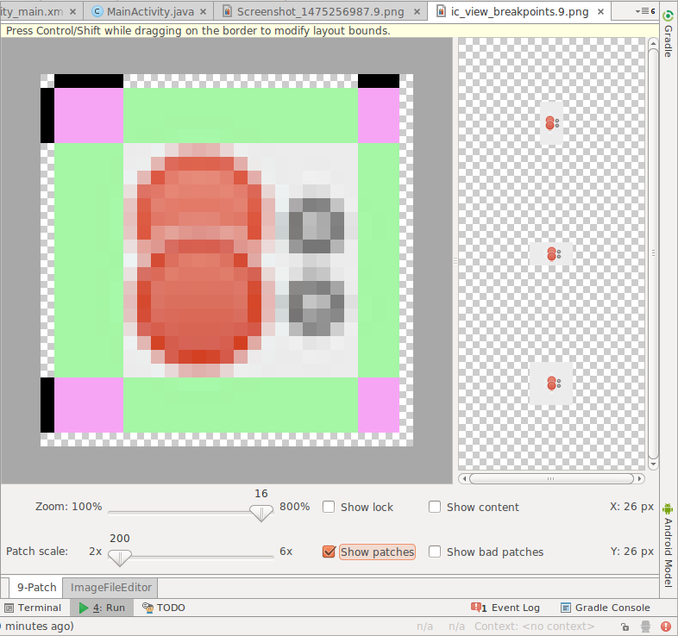
Editing Nine-Patch Files
Border to mark stretchable regions for width
Stretchable regions marked for height Pink == both directions
Click to turn pixels black. Shift-click (ctrl-click on Mac) to unmark
Stretchable area
Not stretchable
Check Show patches
Preview of stretched image
1
7
2
3
4
5
6

Slide 12
Layer List
You can create layered images, just like with drawing tools, such as Gimp
In Android, each layer is represented by a drawable
Layers are organized and managed in XML
List and the items can have properties
Layers are drawn on top of each other in the order defined in the XML file
LayerDrawable

Slide 13

Creating Layer List
<layer-list>
<item>
<bitmap android:src="@drawable/android_red"
android:gravity="center" />
</item>
<item android:top="10dp" android:left="10dp">
<bitmap android:src="@drawable/android_green"
android:gravity="center" />
</item>
<item android:top="20dp" android:left="20dp">
<bitmap android:src="@drawable/android_blue"
android:gravity="center" />
</item>
</layer-list>

Slide 14
Shape Drawables & GradientDrawable
Define a shape and its properties in XML
Rectangle, oval, ring, line
Styled with attributes such as <corners>, <gradient>, <padding>, <size>, <solid> and <stroke>
See Shape Drawables for more attributes
Can be inflated for a GradientDrawable

Slide 15

Creating a GradientDrawable
<shape … android:shape="rectangle">
<gradient
android:startColor="@color/white"
android:endColor="@color/blue"
android:angle="45"/>
<corners android:radius="8dp" />
</shape>
Resources res = getResources();
Drawable shape = res.getDrawable(R.drawable.gradient_box);
TextView tv = (TextView)findViewByID(R.id.textview);
tv.setBackground(shape);

Slide 16
Transition Drawables
Drawable that can cross-fade between two other drawables
Each graphic represented by <item> inside <selector>
Represented by TransitionDrawable in Java code
Transition forward by calling startTransition()
Transition backward with reverseTransition()

Slide 17
Creating Transition Drawables
<transition ...>
<selector> <item android:drawable="@drawable/on" />
<item android:drawable="@drawable/off" />
</selector>
</transition>
<ImageButton
android:id="@+id/button"
android:src="@drawable/transition" />
ImageButton button = (ImageButton) findViewById(R.id.button);
TransitionDrawable drawable =
(TransitionDrawable) button.getDrawable();
drawable.startTransition(500);

Slide 18
Vector drawables
Scale smoothly for all screen sizes
Android API Level 21 and up
Use Vector Asset Studio to create (slides below)
VectorDrawable

Slide 19

Creating Vector drawables
<vector ...
android:height="256dp" android:width="256dp"
android:viewportWidth="32" android:viewportHeight="32">
<path android:fillColor="@color/red"
android:pathData="M20.5,9.5
c-1.955,0,-3.83,1.268,-4.5,3
c-0.67,-1.732,-2.547,-3,-4.5,-3 ... />
</vector>
pathData for heart shape

Slide 20
Image Asset Studio

Slide 21
What is Image Asset Studio?
Create icons from material icons, images, and text
Launcher, action bar, tab, notification icons
Generates a set of icons for generalized screen density
Stored in /res folder
To start Image Asset Studio
Right-click res folder of your project
Choose New > Image Asset

Slide 22
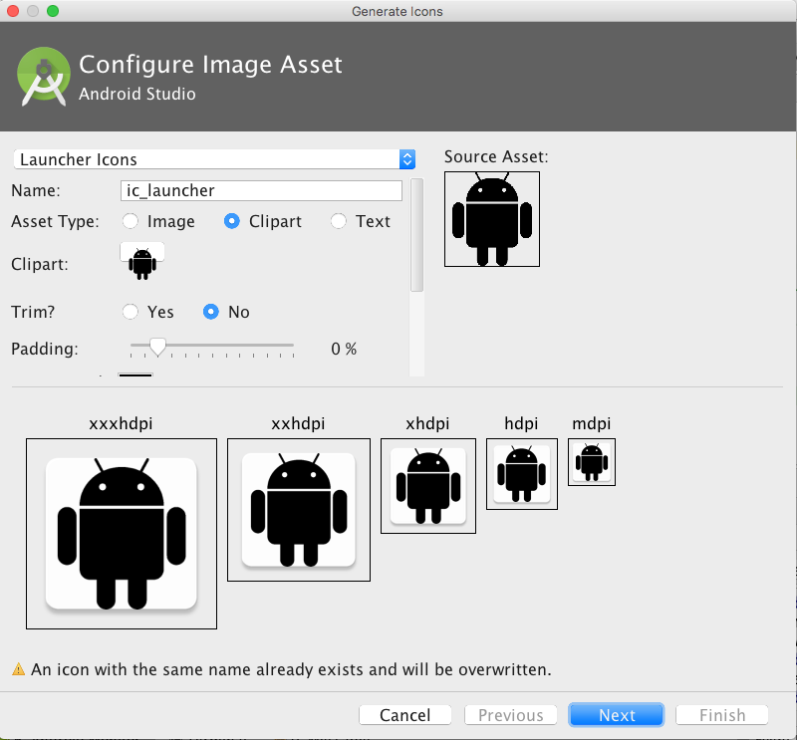
Using Image Asset Studio
Chose icon type and change name
Choose Image, Clipart, or Text
Click icon to chose clipart
Inspect assets for multiple screen sizes
1
2
3
4

Slide 23
Vector Asset Studio

Slide 24
What is Vector Asset Studio?
Create icons from material icons or supply your own vector drawings for API 21 and later
Launcher, action bar, tab, notification icons
Generates a scalable vector drawable
Stored in /res folder
To start Image Asset Studio
Right-click res folder of your project
Choose New > Vector Asset

Slide 25
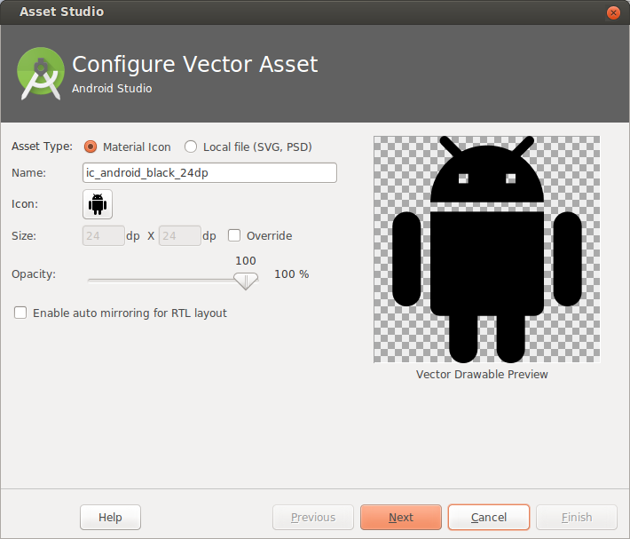
Using Image Asset Studio
Choose from Material Icon library, or supply your own SVG or PSD vector drawing
Opens Material Icon library
1
2

Slide 26
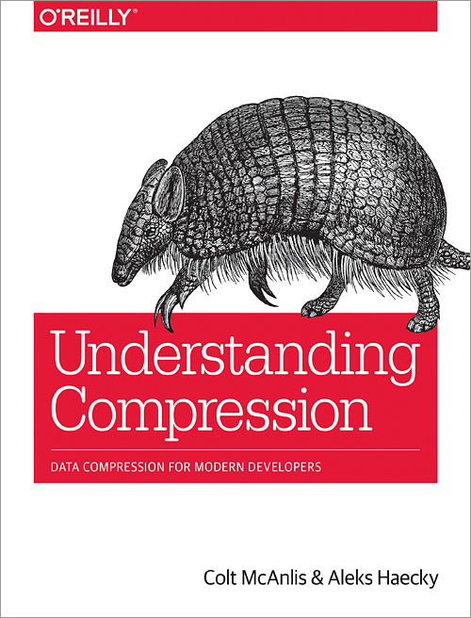
Images, memory, and performance
Use smallest resolution picture necessary
Resize, crop, compress
Vector drawings for simple images
Use Libraries: Glide or Picasso
Choose appropriate image formats for image type and size
Use lossy image formats and adjust quality where possible
Learn about data compression for developers from Understanding Compression

Slide 27
Styles

Slide 28
What is a Style?
Collection of attributes that define the visual appearance of a View
Reduce duplication
Make code more compact
Manage visual appearance of many components with one style

Slide 29
Styles reduce clutter
<TextView
android:layout_width="match_parent"
android:layout_height="wrap_content"
android:textColor="#00FF00"
android:typeface="monospace"
android:text="@string/hello" />
<TextView
style="@style/CodeFont"
android:text="@string/hello" />

Slide 30
Define styles in styles.xml
styles.xml is in /res/values
<?xml version="1.0" encoding="utf-8"?>
<resources>
<style name="CodeFont">
<item name="android:textColor">#00FF00</item>
<item name="android:typeface">monospace</item>
</style>
</resources>

Slide 31
Inheritance: Parent
Define a parent style...
<?xml version="1.0" encoding="utf-8"?>
<resources>
<style name="CodeFont">
<item name="android:layout_width">match_parent</item>
<item name="android:layout_height">wrap_content</item>
<item name="android:textColor">#00FF00</item>
<item name="android:typeface">monospace</item>
</style>
</resources>

Slide 32
Inheritance: Define child
Define child with Codefont as parent
<?xml version="1.0" encoding="utf-8"?>
<resources>
<style name="RedCode" parent="@style/Codefont>
<item name="android:textColor">#FF0000</item>
</style>
</resources>

Slide 33
Themes

Slide 34
Themes
A Theme is a style applied to an entire activity or even the entire application
Themes are applied in the Android Manifest
<application android:theme="@style/AppTheme">

Slide 35
Customize AppTheme of Your Project
<!-- Base application theme. -->
<style name="AppTheme" parent="Theme.AppCompat.Light.DarkActionBar">
<!-- Try: Theme.AppCompat.Light.NoActionBar -->
<!-- Customize your theme here. -->
<item name="colorPrimary">@color/colorPrimary</item>
<item name="colorPrimaryDark">@color/colorPrimaryDark</item>
<item name="colorAccent">@color/colorAccent</item>
</style>

Slide 36

Styles and Themes Resources
Android platform has collection of built in styles and themes
Android Styles
Android Themes
Styles and Themes Guide
DayNight Theme Guide

Slide 37
Learn more
Drawable Resource Documentation
ShapeDrawable
LinearLayout Guide
Drawable Resource Guide
Supported Media formats
9-Patch
Understanding Compression

Slide 38
What's Next?
Concept Chapter: 5.1 C Drawables, Styles, and Themes
Practical: 5.1 P Drawables, Styles, and Themes

Slide 39
END

